Slide 1
Portfolio Analysis
BCG Tool for Analyzing Opportunities & Ability to Compete

Slide 2
Growth Share Matrix (Boston Consulting Group)
Classification of SBUs/products into four cell matrix based on
  Market Attractiveness
  Business Strength

Slide 3



The Boston Consulting Group’s Growth-Share Matrix
20%-
18%-
16%-
14%-
12%-
10%-
8%-
6%-
4%-
2%-
0
Stars
Question marks
4
3
?
?
1
?
5
2
Market Growth Rate
Cash cows
Dogs
8
7
6
10x 4x 2x 1.5x 1x
.5x .4x .3x .2x .1x
Relative Market Share

Slide 4

Star Strategies
Leader expanding industry
Generates large profits
Requires substantial investments to sustain growth
Farthest down on experience curve relative to competition
Increase sales – e.g. new markets, new channels of distribution
Increase market share

Slide 5

Question Mark
Low market share in expanding industry
Needs substantial cash to improve its position
Slow progress on experience curve
Increase sales (limit to niche or increase market share (limit to niche)
Leave market

Slide 6

Cash Cow
Leader in mature or declining industry
Can generate funds for other SBUs
Maintain market share e.g. ensure quality, build customer loyalty, develop substitute brands
Maximize Cash Flow e.g. increase usage rate, rate of replacement, modify expense structure, raise prices

Slide 7
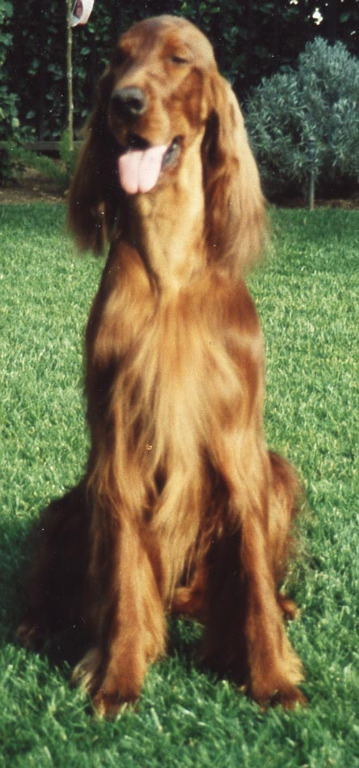
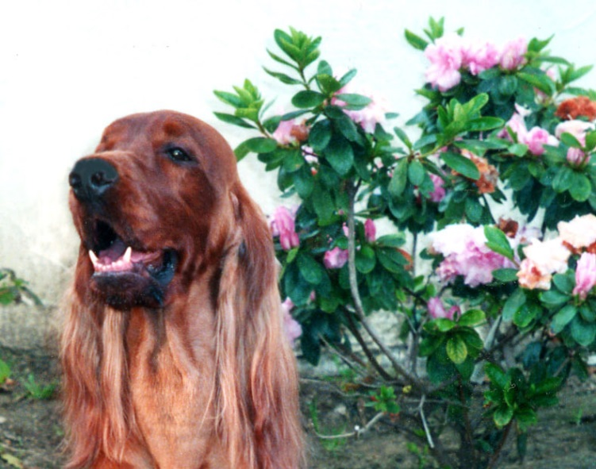
Dogs
Low market share in a mature or declining industry
Slow progress on experience curve
Cost disadvantages and few growth opportunities
Harvest or Divest
Concentrate on niches requiring limited effort

Slide 8
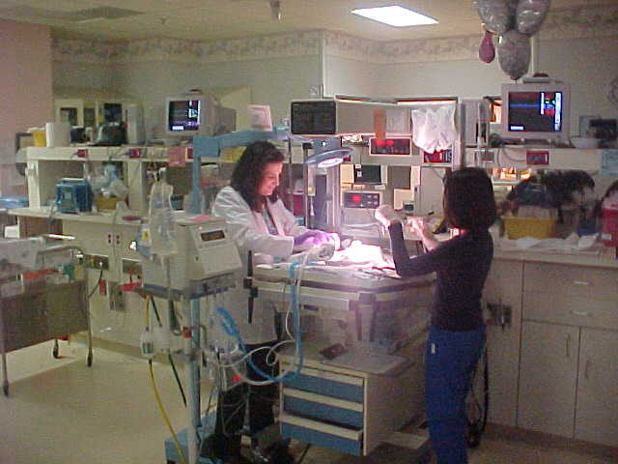
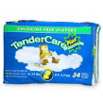
The Boston Consulting Group’s Growth-Share Matrix
20%-
18%-
16%-
14%-
12%-
10%-
8%-
6%-
4%-
2%-
0
Market Growth Rate
10x 4x 2x 1.5x 1x
.5x .4x .3x .2x .1x
Relative Market Share

Slide 9
Strategy Implications BCG
Star – Leader in Expanding Industry
  BUILD - Continue to increase market share – if necessary at expense of short-term earnings
Question Mark – Low market share in Expanding Industry
  HARVEST if weak, BUILD if strong.
  Assess chances of dominating segment. If good, go after share. If bad, redefine business or withdraw.

Slide 10
Strategy Implications BCG
Cash Cow – Leader in mature or declining industry
  HOLD - Maintain share and cost leadership until further investment becomes marginal
  Maximize cash flow
Dogs – Low market share in a mature or declining industry
  DIVEST Plan an orderly withdrawal so as to maximize cash flow or concentrate on niches that require limited effort

